Slide 1
Old English Literature
Background for Beowulf & English Culture Circa 500 ad

Slide 2
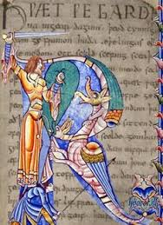
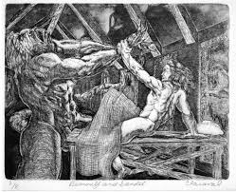
Literature & History Collide
England has a diverse history that brought together different cultures & languages to create elaborate legends.
Pagan Germanic tribal culture mixed with Roman Christianity to create complex tales of heroes & monsters.

Slide 3
History
55 BC Caesar invades Briton.
43-83 AD Claudius colonizes Briton.
What does it mean to colonize something?
How might the colonization of a place change its culture?

Slide 4
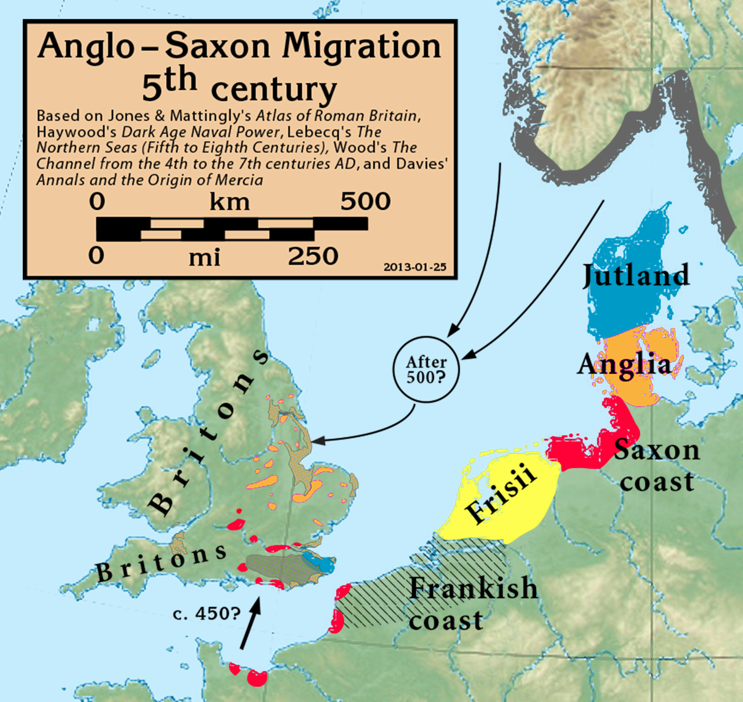
British History—The Anglo-Saxon Period
Rome ruled Briton for around 300 years.
They brought with them:
Christianity
Next came Anglos, Saxons, and Jutes.
These were Germanic tribes. Traditionally these tribes would would invade, plunder, and leave; however, they chose to settle in Briton.
They brought with them:
Paganism
Germanic Languages (What we know of as “Old English”)
https://www.youtube.com/watch?v=mVyXDYp60BE
Germanic Paganism fused with Roman Christianity to create a unique culture in Anglo-Saxon Briton.
This is the time of Beowulf.

Slide 5
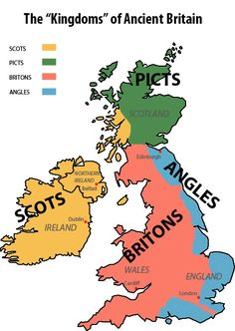
The Pict: Fierce group of people.
Painted images on themselves.
Polytheistic
All men were warriors
Associated with piracy

Slide 6
Briton & Hadrian’s Wall
The Britons in the south were fearful of the Pict. So the Roman colonial government built “Hadrian’s Wall” to keep them out.
The barrier kept Britons safe and “Londinium” was developed in 200 AD.
By 350 AD Christianity had emerged in Briton.
By 410 AD Rome was weakening and they left Briton.

Slide 7
Patricius
Who was Patricius?
Briton, kidnapped to Ireland at the age of 16.
Ended up herding sheep as a slave.
One night, he had a dream that told him his “ship was ready; it was time to go”. He escaped on a ship to Italy. There he joined a church and became a christian.
Had another dream telling him to return to Ireland as a missionary.
Famously used Shamrock to illustrate the trinity.
St. Patrick!

Slide 8
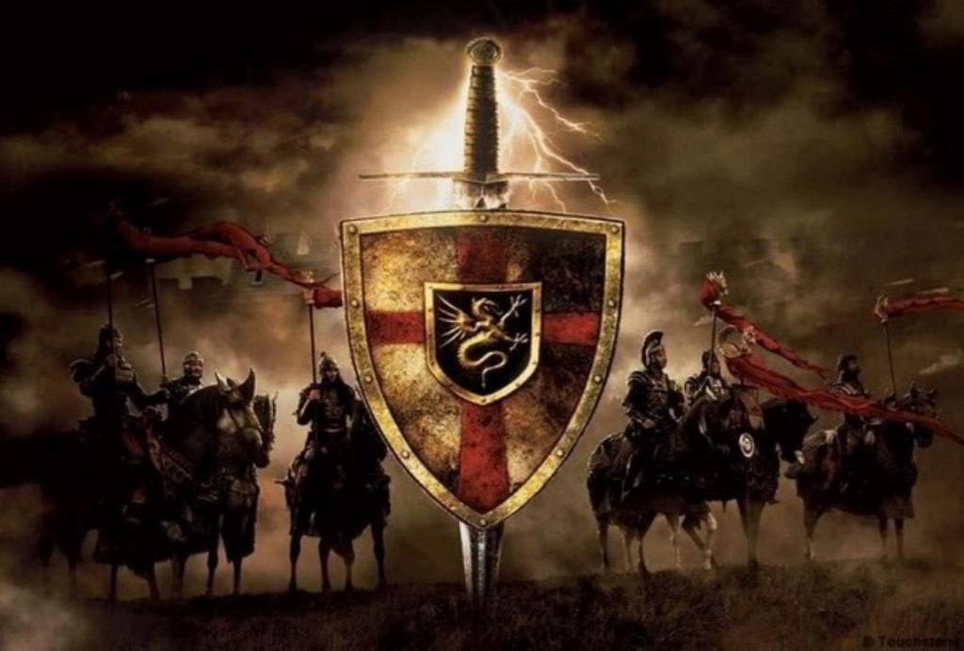
Arturus
The Saxons were looking to expand their territory.
They began to attack the East Briton.
A young leader named Arturus defended his people from the Saxons for over 50 years.
He is now known as King Arthur & he and his knights have become legends

Slide 9
Iona
E. coast of Scotland.
Became a refuge for Celtic Christians during this “dark” period (during the Dark Ages).
They saved the culture of Rome. Islam saved the culture of Greece

Slide 10
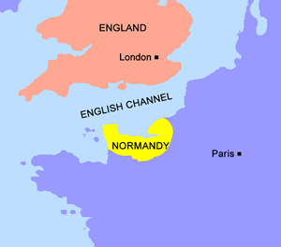
British History—The Middle Ages
1066 “Battle of Hastings”—William the Conqueror came from France, claimed he had rights to the Briton’s throne, invaded and won.
He brought French language to Briton (Mixed with Old English and created what we know as Middle English).
www.pinterest.com/pin/276127020879853358/
This is the time of Chaucer’s Canterbury Tales.

Slide 11
Old English Literature
The Exeter—collection of manuscripts that contains pieces of the Old English oral tradition. Compiled by monks
This means Christian monks were recording pagan oral stories.
What ramifications might this have for the literature of the time?

Slide 12
Excerpt from
“The Exeter”
Anglo-Saxon Culture brought:
warrior culture
seafaring tradition
pagan beliefs
grim, fatalistic view of the world!

Slide 13
Old English Literature
All was originally disseminated orally.
Literature from this period is highly reflective of the culture.
Heavy elements of Old English Feudalism & the Germanic Code, including but not limited to:
Courage, Loyalty, & Honor
Thane (warrior) & his Lord
Comitatus—Thane gives love, loyalty, & obedience to the Lord, the Lord will take care of his needs.
Ring-giver—Principle used in OE literature to define the character that offers the spoils of wealth to thanes who fight well.
Place of cultural importance—OE literature often uses the Mead Hall
Kenning—two word metaphor to represent an object. (ring-giver= Lord, whale road=ocean)
Wergild—”man-price” paid for compensation of death of family member

Slide 14
Synechdoche—when you use part of a name to reference the whole.
Metonymy—when you substitute the name of an attribute instead of the name itself
Scop—traveling performers
Caesuras—rhythmic break in the middle of each line, shown on the page with a space
Assonance—Repetition of vowel sounds, often in the middle of a word (batter these ramparts)
Alliteration—Repetition of consonant sounds at the beginning of the word (peter piper picked a peck)
Boasting—popular in old English culture, boast in order to be respected, to be understood.

Slide 15
Old English Poetry
Epic
Long
Archetypal Hero (represents more than themselves).
Grand scale
Supernatural Events
Long journeys/Supernatural Events
Good always wins—the hero always saves the day
Elegy—lyric poem that mourns the loss of someone.
Lyric Poetry—
Expresses personal feelings
Originally meant to be sung
Addresses the reader directly

Slide 16
Beowulf
Epic Poem
Links past (Roman period) to the future (Medieval period)
Remember, it is recorded by a Christian monk.

