Slide 1
Critical Reading
Why & How?

Slide 2
Why do a close reading?
College-level reading is complex & requires interaction with the text. Professors will expect you to analyze a text, not simply consume information.
A close reading will increase your retention & understanding of whatever text you are reading.

Slide 3
It Helps in Your Writing
Often times college reading leads to college writing. If you have closely analyzed a text or piece of information, then you will be better able to write about it.

Slide 4
How Do You Do a Close Reading?
Read with a pen in your hand
Underline parts of the text you feel are important
Summarize portions of the text in the margins
This enables you to not have to re-read the entire piece later when studying!
Join the conversation!
Write your interactions w/the text in the margins
Not just your thoughts! That can be simplistic & elementary.
Look at content & structure
Not just what is being said, but how it is being said

Slide 5
How Do You Do a Close Reading?
3. Notice patterns: repetition, contradictions, comparisons, etc.
4. Ask questions of the text—how & why

Slide 6
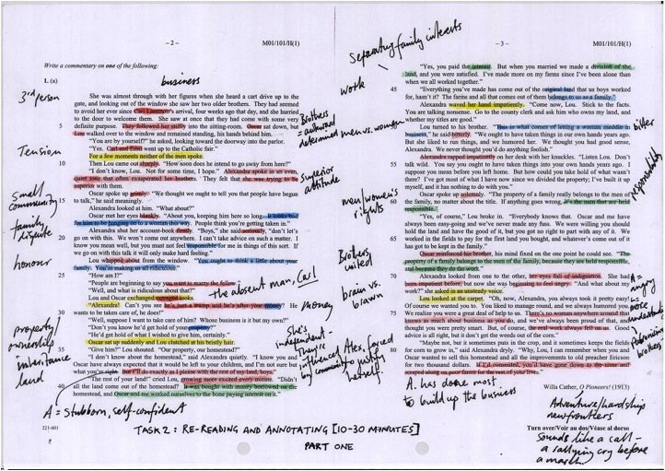
What Does it Look Like?

